Slide 1



Slide 2
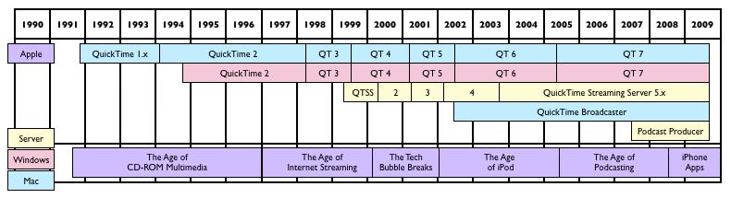
QuickTime
player
architecture
container
<number>/30

Slide 3

player
Save files from the Internet
Edit audio and video
Record audio (Mac OS X and Windows) and video (Mac OS X only)
Convert and save video, audio, and images to more than a hundred standard formats
Simultaneously playing multiple movies
Navigating a Movie by Frame Number/ Time Code
https://www.apple.com/quicktime/
<number>/30

Slide 4
Types of Files QuickTime Supports
Video formats: MOV, MPEG-1, MPEG-2, MPEG-4( .mp4, .m4v), 3GPP, 3GPP2, AVI(Motion JPEG only), DV, MQV
Video codecs: MPEG-2, MPEG-4 (Part 2), H.261, H.263, H.264, Apple ProRes, Apple Pixlet, Animation, Cinepak, Component Video, DV, DVC Pro 50, Graphics, Motion JPEG, Photo JPEG, Sorenson Video 2, Sorenson Video 3 .etc
Audio formats: AIFF/AIFC, MP3, WAV, iTunes audio (.m4a,.m4b,.m4p), AU, SD2, SND, AMR, MIDI
Audio codecs: AAC( MPEG-4 audio), HE-AAC, MP3, AMR Narrowband, MS ADPCM, A-law 2:1 .etc
Still-image formats: BMP, GIF, JPEG/JFIF, JPEG 2000, PDF, MacPaint, PICT, PNG,Photoshop (including layers), SGI, Targa, FlashPix (including layers), TIFF (including layers), QuickTime Image File, Truevision TGA
Animation formats: Animated GIF, FLC, Flash, PICS
Other formats: KAR (Karaoke), QuickDraw GX, Text, M3U (MP3 Playlist files), PLS(playlist)
mime type:video/quicktime,application/x-quicktimeplayer
<number>/30

Slide 5

timecode
时间码是摄像机在记录图像信号的时候，针对每一幅图像记录的唯一的时间编码。它一种应用于流的数字信号。该信号为视频中的每个帧都分配一个数字，用以表示小时、分钟、秒钟和帧数。
<number>/30

Slide 6
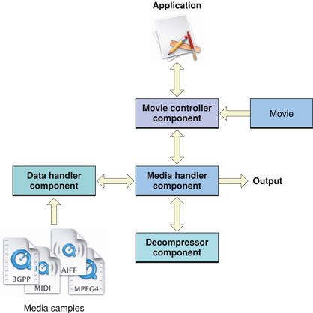
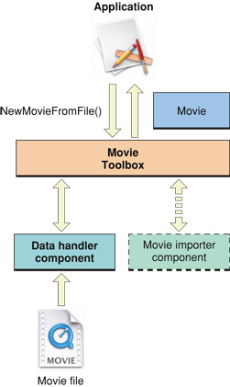
Cross-platform Architecture
工具集（tool sets) & 组件
e.g. 1. Getting a movie
2. Playing a movie
https://developer.apple.com/library/mac/documentation/QuickTime/Reference/QTRef_TrackAndMedia/#//apple_ref/doc
http://aitech.ac.jp/hishida/lab/kobayashi/qtjavadocs/overview-tree.html
<number>/30

Slide 7
Container Outline
QuickTime Movies
  Movie – Track – media – sample
  time-based
Atoms
  important atoms
  media Info
  Random access (seek)
Simple edit
MOV BUG
<number>/30

Slide 8
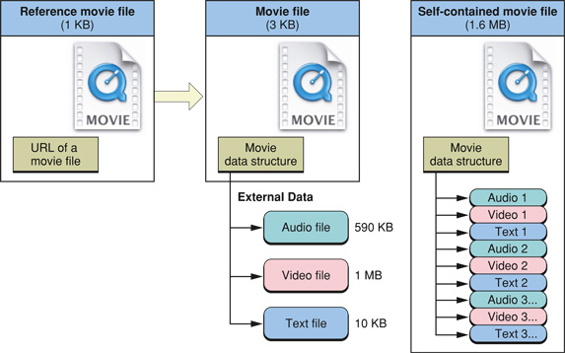
movie
movie是实际数据的引用，且movie 与实际数据相分离，使得数据便于编辑,更多的：
What type of media to present
Where the data is located
When and how to present each sample
How to layer, arrange, and composite multiple elements
<number>/30

Slide 9
track
Track | Description
Video Track | Digitized video, rendered 3D animation, or any other compiled image sequence, with optional special effects.
Audio Track | CD-quality audio or other audio formats.
Music Track | MIDI music with QuickTime instruments
Timecode Track | Contains the timecode information that allows QuickTime to interpret media samples within a movie.
Quartz Composer Track | Used to create motion graphics animation based on OpenGL, Core Image, and Core Video technologies. These animations are called "Quartz Composer compositions" and are stored in ".qtz" files.
Text Track | Text imported into QuickTime for titles, subtitles, credits, notes, and other uses.
Chapter Track | A type of text track that divides and index the movie into sections.
HREF Track | Text track containing interactive or automatic URL lines.
Sprite Track | Contains one or more small images with animatable, programmable behaviors; useful for signs, symbols, games, and effects.
3D Track | Contains 3DMF (QuickDraw 3D metafile) objects.
Flash Track | Incorporates Adobe Flash (.swf) animation.
Streaming Track | Contains a reference to a live stream or a movie on a streaming server.
Hint Track | Contains information that allows a streaming server to deliver a media track as a real-time stream.
<number>/30

Slide 10
Track tips
每一个track中的 media type、data reference、compression format 均需相同
不同的track所含Media type可以相同，e.g. 多音轨、多字幕视频。
List of references--Track edit lists
  更改track的显示顺序，非破环性编辑
  更改track 的duration,便于非正常速度播放
  Track若未被编辑，edit list is empty, 此edit为1个single segment
<number>/30

Slide 11
media
Media describes the location, duration, and natural time scale of the media sample data.
Media 指定具体的data type.
Media 区分不同的track.
<number>/30

Slide 12
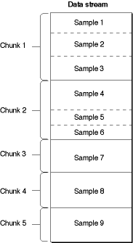
sample
Tips:
chunks may have different sizes;
samples within a chunk may have different sizes & duration.
<number>/30

Slide 13
time-based media files
Movies are containers that hold all of the information needed to organize data in time.
  Time scale: A time value that indicates the time scale for this movie—that is, the number of time units that pass per second in its time coordinate system.
  Duration: A time value that indicates the duration of the movie in time scale units.
  time coordinate system: time scale + duration, it establishes the translation between real time and movie time.
Contrast
  media time scale
  track duration
  sample duration
<number>/30

Slide 14
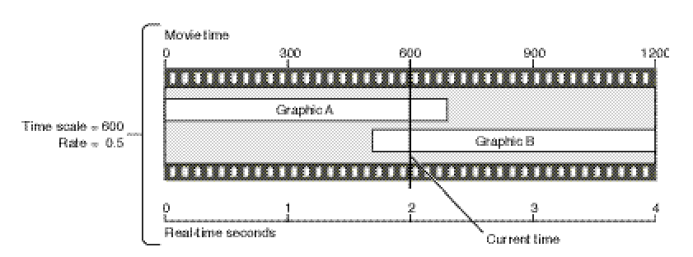
Playback time base
4 track sync
Time base
  Time-coordinate system
  rate
  current time
  clock component
<number>/30

Slide 15
rate
Rate: A value that specifies the pace at which time passes for a time base. A time base’s rate is multiplied by the time scale to obtain the number of time units that pass per second.
preferred rate: The default playback rate for a QuickTime movie.
1: play
0: stop
2: play faster
-1: play backward
<number>/30

Slide 16
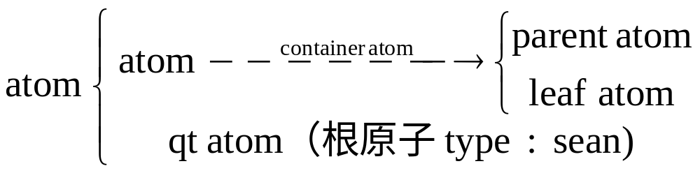
atom
The basic unit of data in a movie resource, sprite, or other QuickTime data structure.
Big-endian format
无次序限制
<number>/30

Slide 17
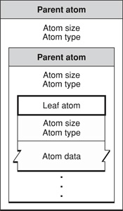
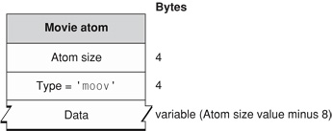
atom
Atom Structure: header + data
<number>/30

Slide 18
Basic atom types
Atom type | Use
'ftyp' | File type compatibility—identifies the file type and differentiates it from similar file types, such as MPEG-4 files and JPEG-2000 files.
'moov' | Movie resource metadata about the movie (number and type of tracks, location of sample data, and so on). Describes where the movie data can be found and how to interpret it.
'mdat' | Movie sample data—media samples such as video frames and groups of audio samples. Usually this data can be interpreted only by using the movie resource.
'free' | Unused space available in file.
'skip' | Unused space available in file.
'wide' | Reserved space—can be overwritten by an extended size field if the following atom exceeds 2^32 bytes, without displacing the contents of the following atom.
'pnot' | Reference to movie preview data.
<number>/30

Slide 19
Type determine structure
E.g. 1st atom ‘ftyp’
More ref: quicktime file format
TOOLS: winhex, ultraedit;
atom viewer
 | Bytes
File type atom
Size | 4
Type = ‘ftyp’ | 4
Major_Brand=‘qt ‘ | 4
Minor_Version | 4
Compatible_Brands[ ] | Size-16
<number>/30

Slide 20
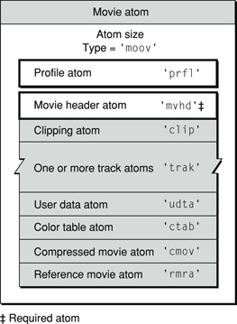
Movie atom
One-track video movie atom
<number>/30

Slide 21
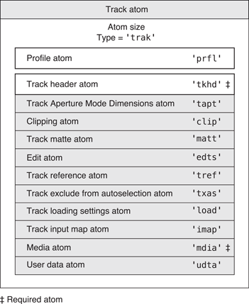
track atom
<number>/30

Slide 22
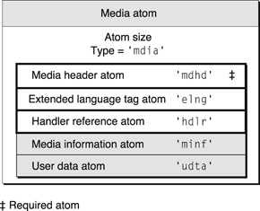
media atom
<number>/30

Slide 23
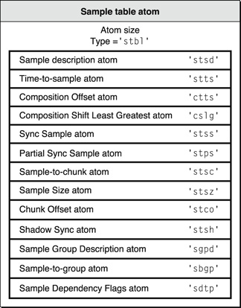
sample table atom
<number>/30

Slide 24
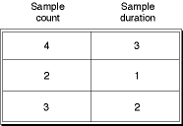
time-to-sample table
time-to-sample table entry
<number>/30

Slide 25
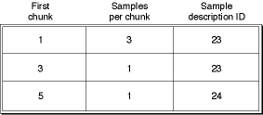
sample-to-chunk table
sample-to-chunk table entry
<number>/30

Slide 26
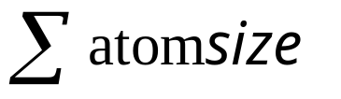
Media Info query
大小：
时长： duration/timeScale
分辨率：sample description atom
Codec: sample description atom
Frame rate: time-to-sample atom
Title: text track / user data atom
关键帧： sync sample atom
Total Average Bit Rate = Total Data / Total Time
<number>/30

Slide 27
Random access
E.g. sample.mov 1s对应的frame
Step1. time-to-sample table, time scale=600, each sample duration =20, 1s对应sample为600/20+1 = 31个sample；
Step2. sample-to-chunk table, 该sample对应第4个chunk中第7个位置；
Step3. chunk-offset table, 第4个chunk偏移量：0x2791
Step4. sample size table, sample 对应偏移量：0x2791+46+78+59+131+62+134=0x298F
<number>/30

Slide 28
Edit insatnce
Player edit for better understand atom, e.g.
add video track
add sound/subtitle track
split media
比较
<number>/30

Slide 29
MOV bug
视频显示时间有误:
maybe 含多个video track
MSDOTZS-405: 视频播放加载过程死机:
stts 信息较多，超过memory限制
无法快进快退：
maybe 不含关键帧 stss (MSTAR)
视频卡顿
bitrate 过高
<number>/30

Slide 30


<number>/30

